Slide 1
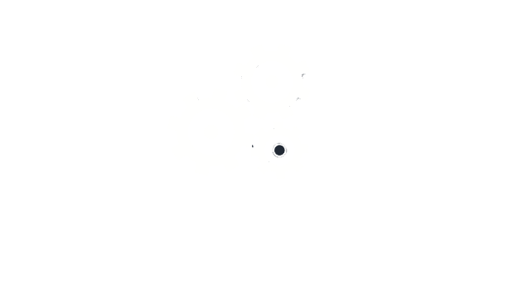
Applying NLP to aid drug discovery
Machine Learning Prague
Workshop
ML Prague, 2023
Aisling O’Sullivan, PhD
Senior data scientist, Dataclair AI Centre

Slide 2

Workshop structure
Introduction to drug discovery and diseases
What are proteins and small molecules?
How to use machine learning for drug discovery?
Data sources and feature representations
Introduction to NLP on language as we know it
NLP for drug discovery
NLP for small molecules
The future of AI in drug discovery

Slide 3
Motivation
Why use Machine Learning to help with drug discovery?​
Notes:
Because...
Is it needed there?
What knowledge gaps can it fill?
Will it generate value?

Slide 4
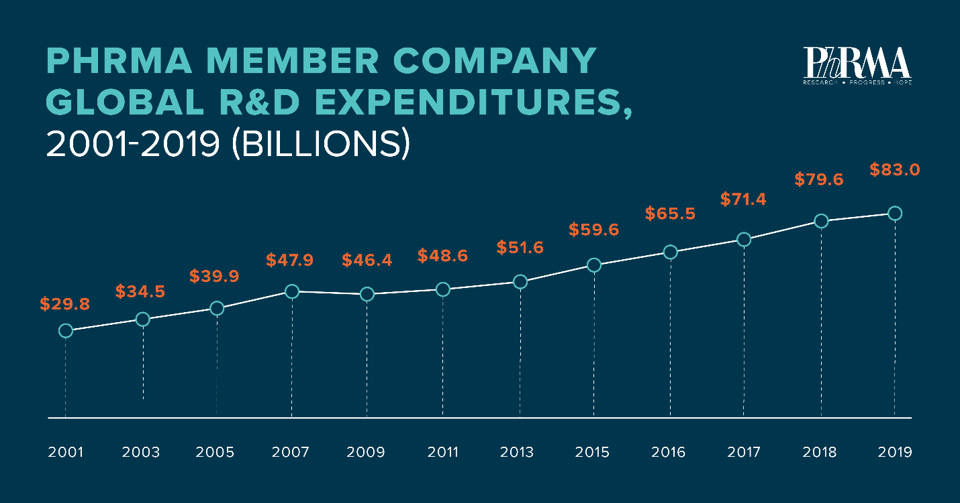
Drug discovery is difficult
Drug discovery is difficult, expensive and important
Average cost is $2.8 billion and takes about 10-15 years¹
90% of drugs that reach human trials fail !
Pharma’s spending on R&D is increasing, $83 billion in 2019
PhRMA member companies R&D expenditure
Why is it so difficult?
Because biology is very complex and unpredictable
¹https://helixr.com/insights/role-of-ai-in-early-drug-discovery/
Hunting for New Drugs with AI. Nature. 2019 Dec; 576(7787):S49-S53.

Slide 5
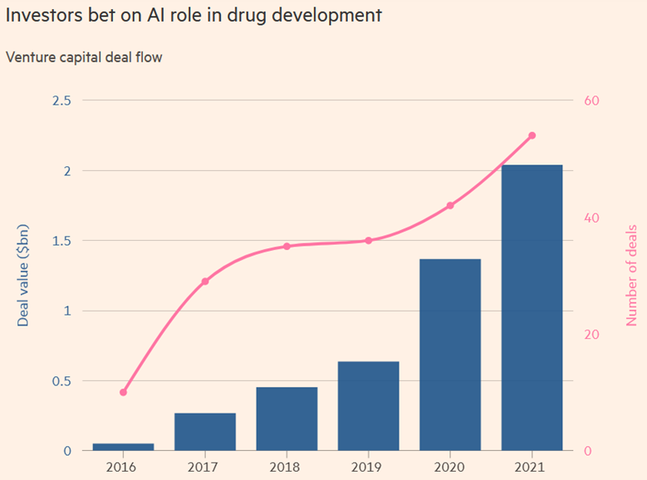
ML accelerates drug discovery
Drugs discovered using AI are already in clinical trials (e.g., Exscientia)²
Cancer drug in 8 months
Usually takes 4-5 years
Raised $525 million
BenevolantAI using named entity recognition to generate connections in their knowledge graph
Found drug for arthritis also helps treat coronavirus, FDA approved
200,000 scientific papers related to the virus have been published!
Treatment for atopic dermatitis (eczema) in phase II clinical trials
Source: FT: Will AI turbocharge the hunt for new drugs
²Tapping into the drug discovery potential of AI, Nature, 2021
doi: https://doi.org/10.1038/d43747-021-00045-7
Notes:
No human could read all these papers on covid-19... how to digest this information and use it?

Slide 6
Drugs and disease
Notes:
Why we need drug discovery
What goes wrong when we have a disease? What’s the root cause?

Slide 7
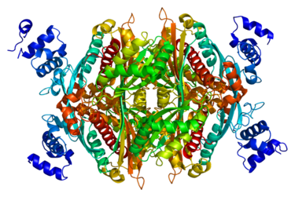
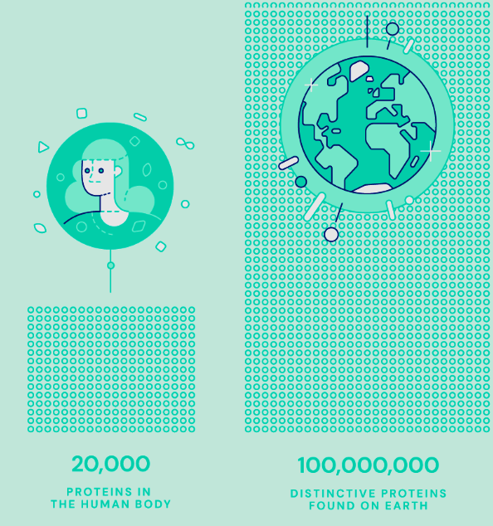

Protein malfunction ~ disease
They underpin the biological processes in your body and every biological process in every living thing
They’re the building blocks of life
There are around 100 million known distinct proteins, with many more found every year
Each one has a unique 3D shape that determines how it works and what it does
Protein that malfunctions
Has disease
Notes:
All proteins can be described by a sequence of amino acids – they are the building blocks of all proteins
There are 20 unique amino acids

Slide 8
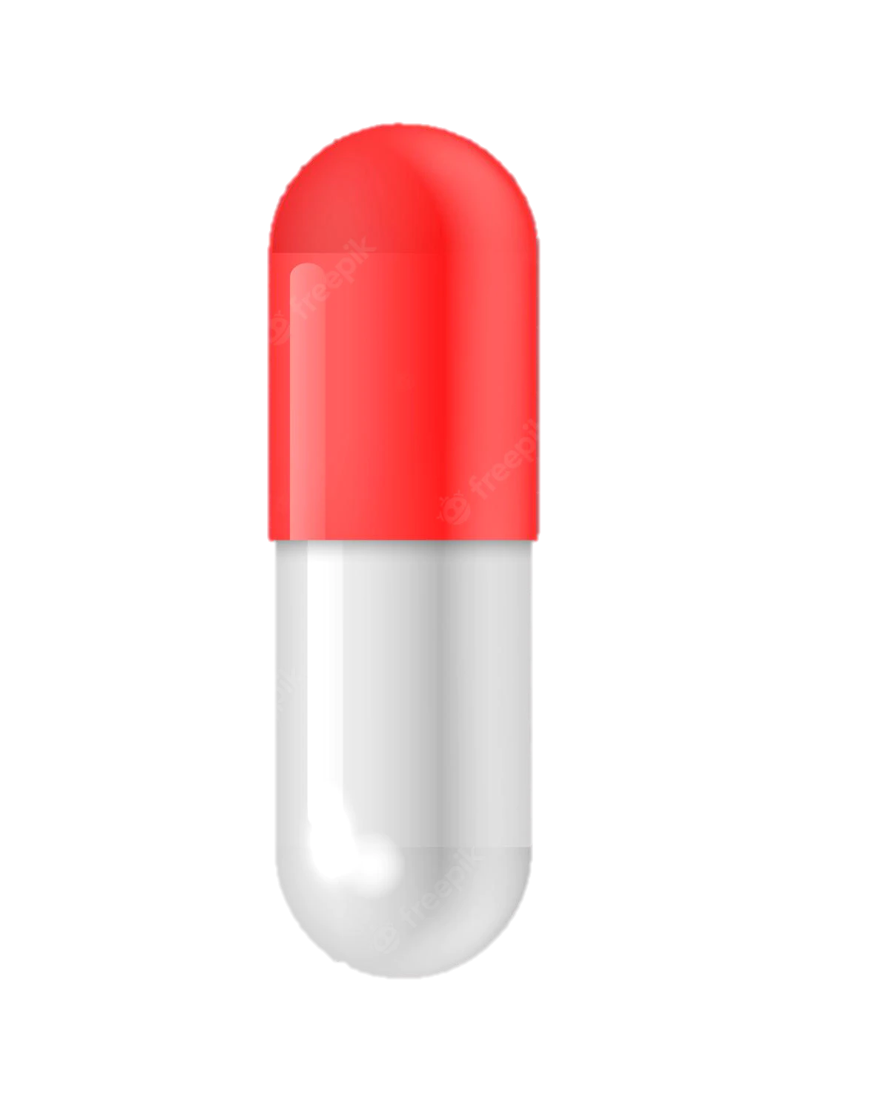
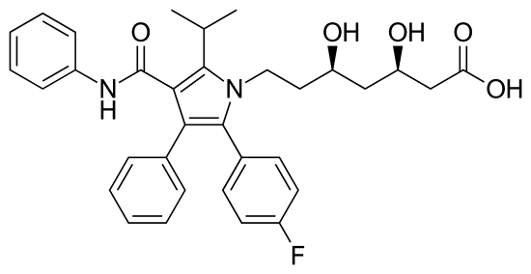
Drugs target malfunctioning protein
Protein that malfunctions
Drug that binds to protein and changes its behavior
Notes:
Drug should alter malfunctioning protein, so the required functionality is restored

Slide 9
Drugs target malfunctioning protein
Protein that malfunctions
Drug that binds to protein and changes its behavior
Drug ~ small molecule

Slide 10
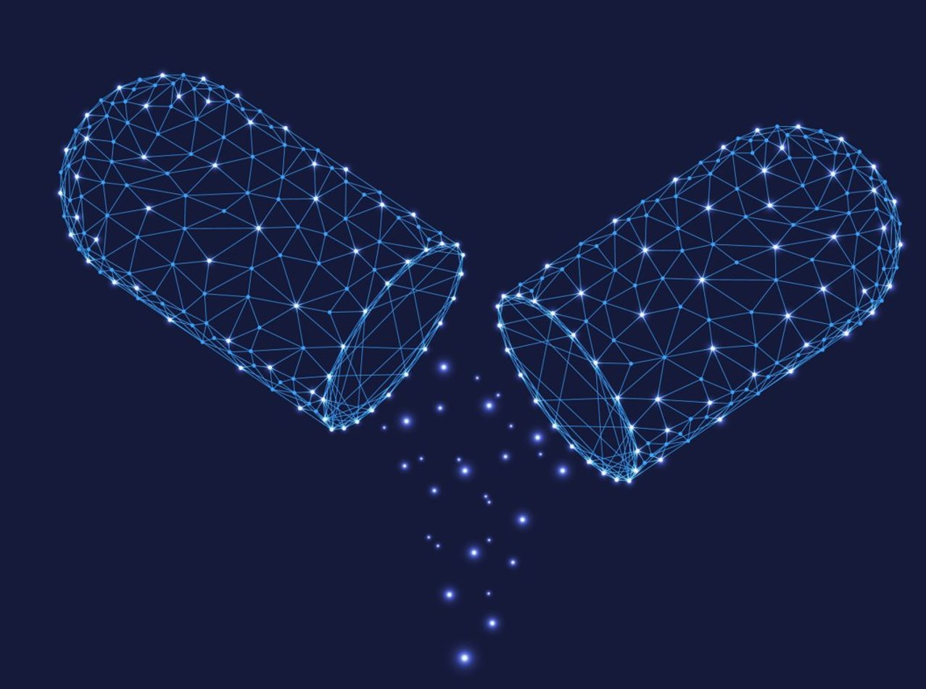
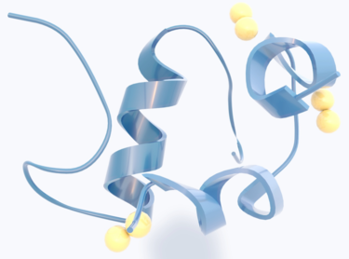
Basics of drug discovery
Most human diseases are caused by a protein (misfolding, overproduced, underproduced, blocked etc.)
To cure a disease, a drug is found that binds to the problematic protein thereby changing its behavior
To design such a drug, you need to know the structure of the protein (so that the drug binds to the protein)
Finding the structure of a protein is very difficult (AlphaFold from DeepMind)
Drugs are usually small molecules (not proteins)
Small molecules more suitable for oral delivery – proteins typically degrade in the stomach/intestines
Insulin
Notes:
Insulin is a protein that is a drug

Slide 11
Workshop structure
Introduction to drug discovery and diseases
What are proteins and small molecules?
Notes:
Important to understand the data that will go into our ML model

Slide 12
Proteins

Slide 13
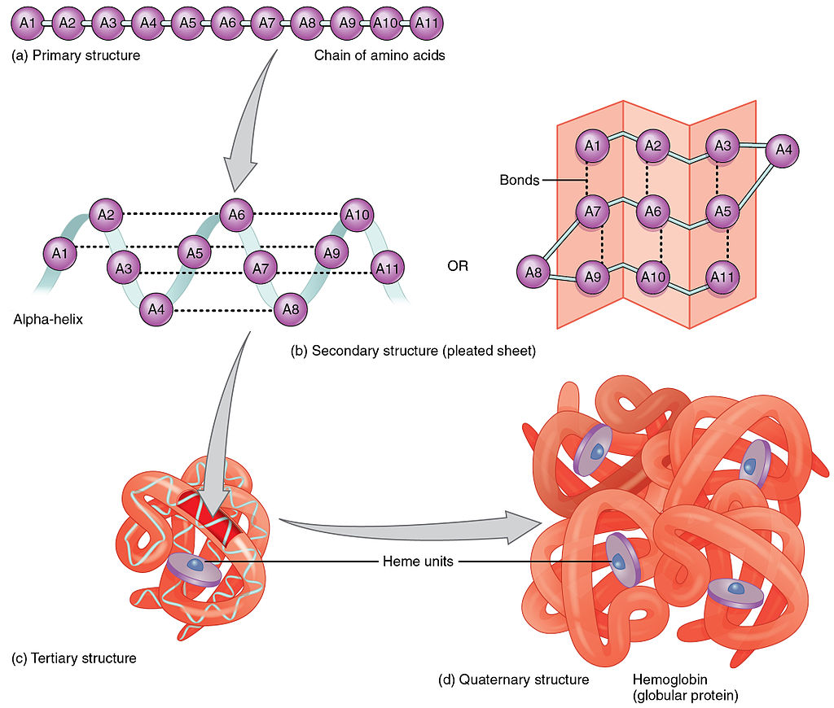
Proteins: sequence of amino acids
Proteins consist of chains of amino acids which spontaneously fold, in a process called protein folding, to form the three-dimensional (3D) structures of the proteins.
The 3D structure is crucial to the biological function of the protein
The structures of about 170,000 proteins over the last 60 years were identified using experimental methods
Notes:
20 amino acids
Each amino acid is a letter – protein is sequence of letters representing amino acids (hundreds/thousands)

Slide 14

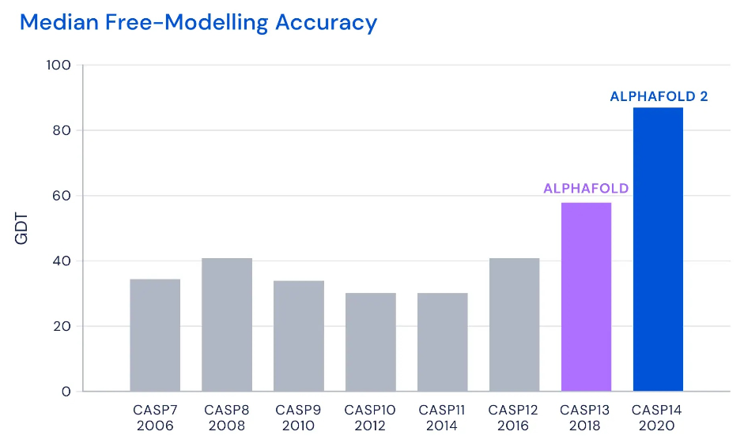
Protein structure: AlphaFold
DeepMind from Google created a revolutionary model in 2020 that can output a proteins 3D structure given its amino acid sequence
It previously took hundreds of thousands of dollars and years of trial and error to find the structure of each protein. AlphaFold can find a protein’s shape in a few days!!
The model was trained for a few weeks on 100-200 GPUs using transformer-based architecture
Since then, they have published structures for 200 million proteins
DeepMind’s protein-folding AI has solved a 50-year-old grand challenge of biology | MIT Technology Review
AlphaFold: a solution to a 50-year-old grand challenge in biology (deepmind.com)

Slide 15
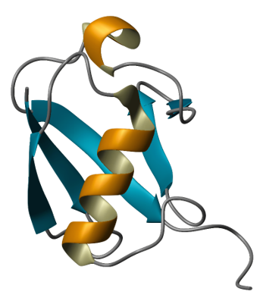
AlphaFold: Outputs
Produced structure of proteins in Covid-19 virus
Produced structure of protein causing rare disease
Scientists could then find a molecule to bind and block the protein curing the disease
If you don’t know the protein structure you can’t do this
DeepMind wants to use its AI to cure neglected diseases | WIRED UK

Slide 16
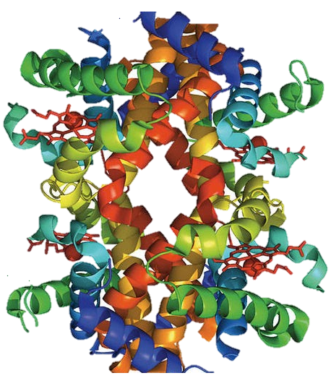
AlphaFold: Consequences for drug discovery
Can we expect to say many new drugs being developed now thanks to AlphaFold?
It helps – but there are more steps to get to the end goal of having a drug that work for a disease
Even if we know the protein shape before binding, after binding we don’t know the shape..
We don’t know how the protein will work now..., enhanced/suppressed..?
AlphaFold cannot do this… yet
Notes:
drug discovery is really hard...

Slide 17
Small molecules (drugs)

Slide 18
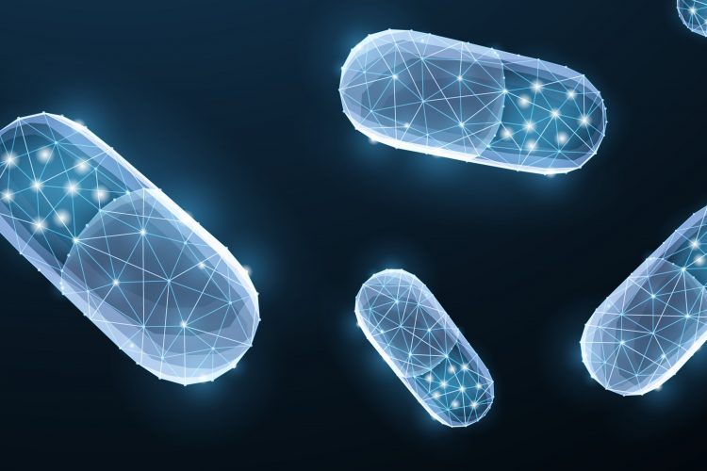
Small molecule – Large search
Approx. 166 billion small molecules exist
How to find one that will work?
Scientists typically select small molecules based on their expert (biased) knowledge and test them
Repeat until they find the desired behavior
Can take a few years…
Notes:
Why are drugs small molecules? They are small (in comparison with proteins) easier to absorb into bloodstream and pass barriers in the body
small molecules (mol. weight < 500 Da). [Dalton = atomic weight]
Proteins are also molecules, but much larger (mol. weight > 10000 Da).

Slide 19
Workshop structure
Introduction to drug discovery and diseases
What are proteins and small molecules?
How to use machine learning for drug discovery?

Slide 20
Machine learning for drug discovery

Slide 21
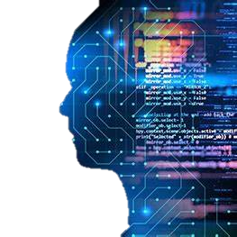
What advantage can AI bring to drug discovery?
Many, many ways – we will just cover 1 application of AI for drug discovery today
We will focus on finding a suitable drug candidate for curing a disease
AlphaFold helps with 1 step, but many more steps
Notes:
Disclaimer! Countless ways – but we will focus on using it for finding the desired drug (this assumes you already have some idea about the problematic protein and so have some criteria which the drug should match)

Slide 22
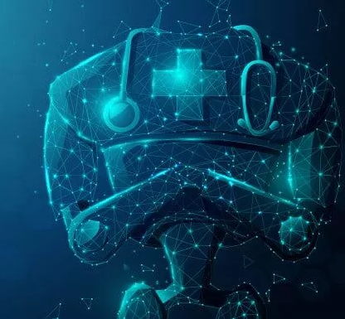
How to find a suitable drug molecule?
Train a machine learning model to identify a desired molecule
This model can be used to score millions of molecules in very short time
Rank these molecules, show them to the expert scientists​
Increase the probability of choosing the right molecule

Slide 23

How to train a model to identify the desired molecule?
Differences between a drug that will work (have the desired effect on the protein) and other drug molecules is difficult to understand
How could a model learn this?
Requires large datasets
Large datasets are hard to come by in medicine
Usually only a handful of successful examples and almost no data on failures because pharma’s keep that to themselves

Slide 24
Workshop structure
Introduction to drug discovery and diseases
What are proteins and small molecules?
How to use machine learning for drug discovery?
Data sources and feature representations

Slide 25
Data and Features
Notes:
healthcare is generating the world’s largest volume of data
It is estimated that by 2025, 36% of the world’s generated data will be healthcare data
https://blog.drugbank.com/data-centric-ai-is-making-waves/

Slide 26
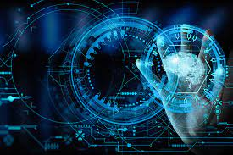
Data
Drug databases
DrugBank: https://go.drugbank.com/drugs/DB01076
PubChem: https://pubchem.ncbi.nlm.nih.gov/compound/60823
Protein databases
UniProt: https://www.uniprot.org/
PDB: https://www.rcsb.org/docs/general-help/organization-of-3d-structures-in-the-protein-data-bank
EMBL: https://www.ebi.ac.uk/services
AlphaFold: https://alphafold.ebi.ac.uk/
Medical Texts
30+ million abstracts on PubMed alone
Clinical trial publications, patents, etc.
Massive amounts of free (unstructured/unlabeled) information but how to utilize it?

Slide 27
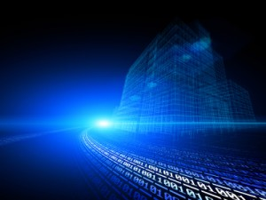
Data: Proteins as a language
Protein sequences can be broken up into smaller parts/words (e.g., 3 amino acids, 1 amino acid is like a syllable/character)​
MAF, SAE, DVL, KEY, DRR, RRM, …​
AFS, AED, VLK, EYD, RRR, RME, …​
FSA, EDV, LKE, YDR, RRR, MEA, ...​
They behave likely natural language, and have some natural language structure
NLP models can be trained (unsupervised) for each of these "biological words" using millions of sequences from a public database
NLP models work not only natural language – can be used for other types of structured text
Notes:
More detail later – we will do NLP on protein sequences

Slide 28
Data: Molecules as a language
Atorvastatin (statin medication)
Text representation for atorvastatin
CC(C)C1=C(C(=C(N1CCC(CC(CC(=O)O)O)O)C2=CC=C(C=C2)F)C3=CC=CC=C3)C(=O)NC4=CC=CC=C4
Called SMILES string (https://chemicbook.com/2021/02/13/smiles-strings-explained-for-beginners-part-1.html)

Slide 29
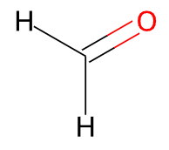
SMILES
Typically, several equally valid SMILES strings can be written for a molecule
For example, C=O and [CH2]=O specify the structure of formaldehyde
Carbon dioxide: O=C=O or C(=O)=O
Formaldehyde
Drawbacks:
Missing 3d information
Flattening the graph into a list of atoms artificially creates variable- and long-range dependencies between bonded atoms
A small change in a molecule can lead to a large change in the SMILES string
Models that are trained to generate/predict SMILES often generate implausible molecules (e.g., bonds somewhere that are not physically possible)
Notes:
difficult to reason about common substructures, because the same structure can be represented in many different ways depending on how the graph was flattened

Slide 30
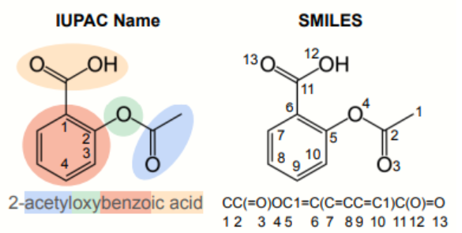
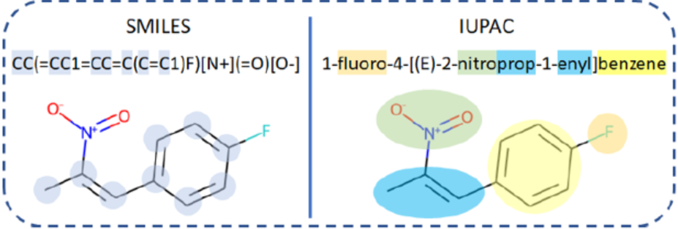
IUPAC – alternative molecule representation
Tokens in IUPAC names correspond to well-known functional groups
Will show later how embeddings are trained for these data
Notes:
The international union of pure and applied chemistry
Both are commonly used – model combined them

Slide 31
Workshop structure
Introduction to drug discovery and diseases
What are proteins and small molecules?
How to use machine learning for drug discovery?
Data sources and feature representations
Introduction to NLP on language as we know it

Slide 32
Natural Language Processing (NLP)

Slide 33
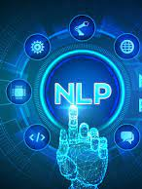
NLP
To use machine learning/computer models on text, we need to convert that text to numbers
Word2Vec³ is one of the most famous methods that converts words to a vector representation (developed by Tomáš Mikolov)
Word2Vec:
Give the algorithm millions of sentences
It learns a vector for each word
Words with similar meaning will have vectors closer together in space
Words with different meanings will have vectors that are further apart
Training task:
Predicts current word given surrounding context (or opposite)
³Mikolov, T., Chen, K., Corrado, G., & Dean, J. (2013). Efficient estimation of word representations in vector space. arXiv preprint arXiv:1301.3781.

Slide 34

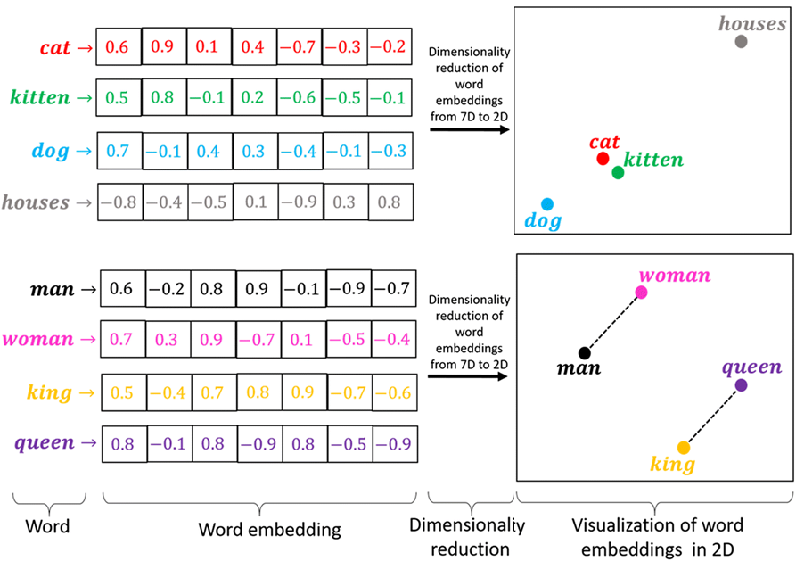
Word embeddings
Example of word vectors
d0 | d1 | d2 | d3 | … | d253 | d254 | d255 | word
0.34 | 0.26 | 0.02 | 0.1 | … | 0.76 | 0.82 | 0.78 | cat
0.45 | 0.16 | 0.05 | 0.2 | … | 0.65 | 0.92 | 0.8 | kitten
0.2 | 0.68 | 0.8 | 0.78 | … | 0.12 | 0.05 | 0.1 | house
cosine distance low
cosine distance high
Notes:
What is cosine distance

Slide 35

Drawbacks of using Word2Vec
“He went to the prison cell with his cell phone to extract blood cell samples from inmates”
Word2Vec (2013)
Words embeddings are averaged across contexts they appear in
Transformers (2017)
Word embeddings are context dependent
Uses "attention" which improves quality of word embeddings (better language understanding)
Task: predicts masked words or next sentence

Slide 36

Transformers
We will used pre-trained transformer models in this workshop
Transformer can be an encoder (e.g., BERT), decoder (e.g., GPT-n) or encoder-decoder (e.g., T5)
We will use encoder models
​
Learn more about transformers:​
🤗 course: https://huggingface.co/course​
4-6 part series explaining transformers: https://towardsdatascience.com/transformers-explained-visually-part-1-overview-of-functionality-95a6dd460452​
Notes:
Encoder: Good for tasks that require understanding of the input, such as sentence classification and named entity recognition.
Decoder: Good for generative tasks such as text generation (chatGPT)
Encoder-decoder or sequence-to-sequence models: Good for generative tasks that require an input, such as translation or summarization.

Slide 37
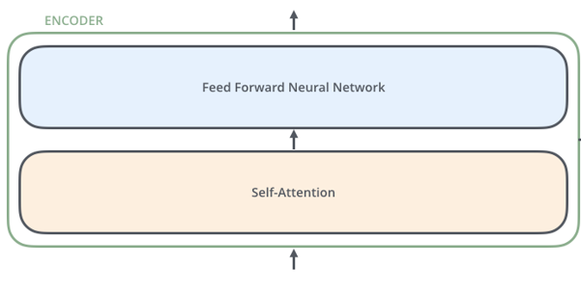
Transformers encoder: Architecture
Fixed input and output size
Bidirectional (sees entire input sequence at once)
Trained by masking words at random
Predicts output all at once
Good language understanding
Typically, 12 layers (More layers = More parameters = More data = More $$)
12-layer encoder, 110 million parameters
Recommended 2 billion tokens needed to prevent under-training
Wikipedia (english, 2.5 billion words )
Training from scratch can cost $1.5-2k

Slide 38
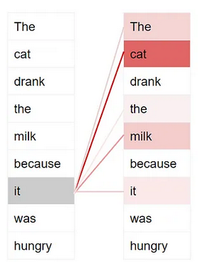
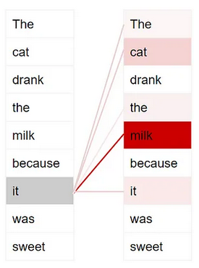
Transformers encoder: Attention
For each word in the input sequence, a score is applied to all other words in that input to reflect how the other words are related to the current word (high score = word is related)
Helps the model learn a better encoding for the current word by looking at the other words in the sentence (self-attention)

Slide 39
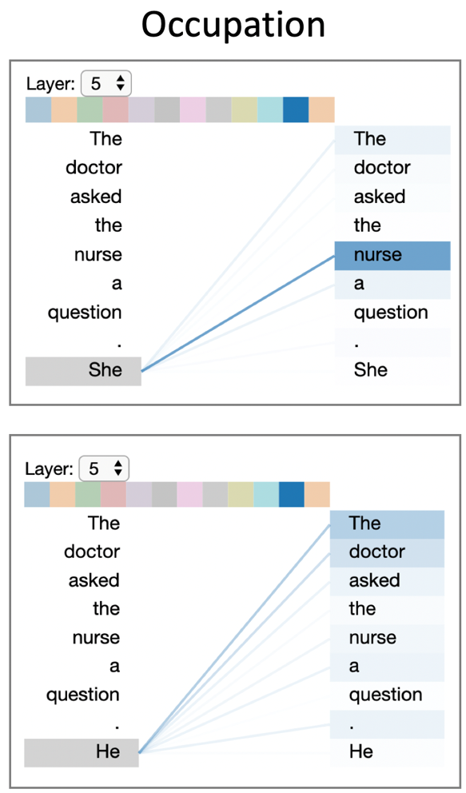
Transformers encoder: Attention
Bias in attention scores
For each word in the input sequence, a score is applied to all other words in that input to reflect how the other words are related to the current word (high score = word is related)
Helps the model learn a better encoding for the current word by looking at the other words in the sentence (self-attention)
Notes:
Be careful using these models – aware of bias
Trained on the internet so you can find much worse and more entertaining examples than this….

Slide 40
First notebook: 01_assignment_intro_to_transformers.ipynb

Slide 41
Workshop structure
Introduction to drug discovery and diseases
What are proteins and small molecules?
How to use machine learning for drug discovery?
Data sources and feature representations
Introduction to NLP on language as we know it
NLP for drug discovery

Slide 42
NLP for drug discovery

Slide 43

Data sources: Text
Published scientific articles are information rich and in large supply
PubMed 30+ million abstracts
With ~2.5 million being published each year⁴
But for humans, articles hard to read, hard to understand, information is not always explicit, readers are biased
Expert scientist cannot read all articles on the topic
Data is not fully utilized
⁴Jinha, Arif E. "Article 50 million: an estimate of the number of scholarly articles in existence." Learned publishing 23.3 (2010): 258-263.

Slide 44


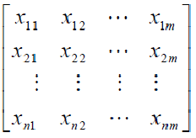
Approach
Harness AI to process the large amount and somewhat cryptic scientific articles
NLP model
Text embeddings
PubMed abstracts
(30 million)
Full-texts
(2 million)
Notes:
We will use transformer model pretrained by microsoft

Slide 45
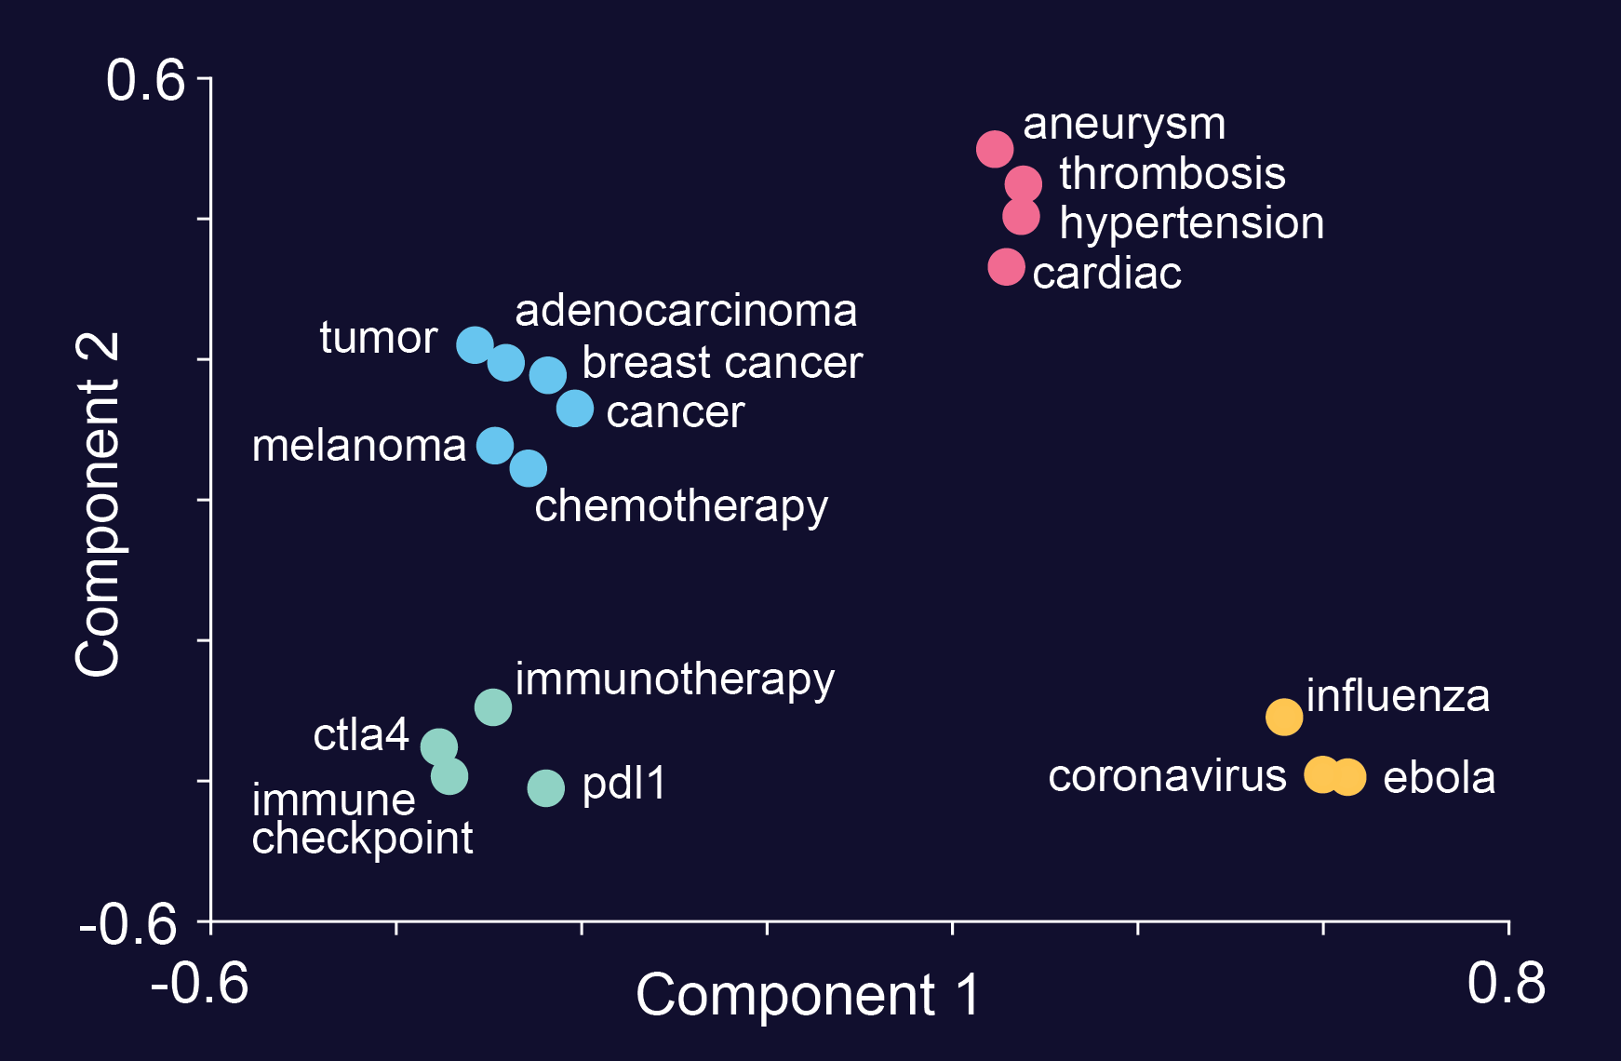
What medical text embeddings look like

Slide 46

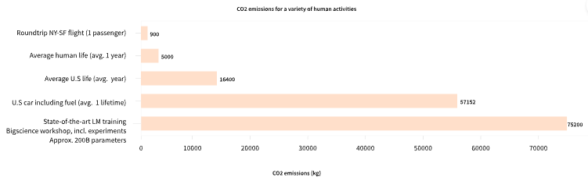
Medical NLP model
NLP models are expensive to train
Many pre-trained models exist that are publicly available
contains ~200k models!
We will use pre-trained models from in this workshop

Slide 47
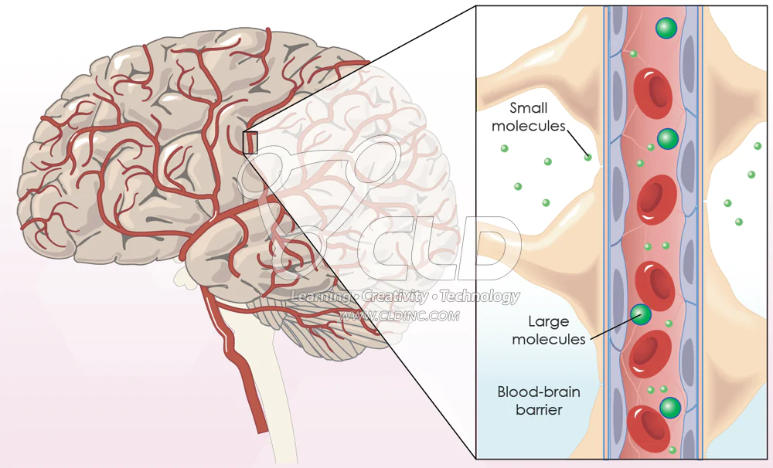
How can we use this medical NLP model?
We will show you how to use this NLP model to find which molecules can cross the blood-brain barrier
The blood-brain barrier is an incredible feature designed to protect one of our most important organs
Consists of border of cells that prevents harmful pathogens/toxins, immune cells, etc. that circulate in our blood-stream from entering our nervous system
Makes it difficult for drugs to get to the brain leading to a major challenge to treat most brain disorders
Do you know a molecule that can cross the blood-brain barrier?

Slide 48
Case study Classify if a molecule can cross the blood-brain barrier

Slide 49
Second notebook: 02_assignment_preprocess_BBB.ipynb Third notebook: 03_assignment_BBB_PubMed_BERT.ipynb

Slide 50
Workshop structure
Introduction to drug discovery and diseases
What are proteins and small molecules?
How to use machine learning for drug discovery?
Data sources and feature representations
Introduction to NLP on language as we know it
NLP for drug discovery
NLP for small molecules

Slide 51
Using NLP for small molecules

Slide 52
Building embeddings for molecules
Molecular embeddings have many advantages over text embeddings
Much larger training datasets than available from text alone
Biomedical texts only contain few tens of thousands of chemical structures, while chemical databases contain hundreds of millions of chemical structures
Ability to predict novel molecules
For text embeddings, the molecule must already exist (maybe a transformer could make up a new molecule name, but this would be very difficult to interpret)

Slide 53

ChemBERTa: what is it
ChemBERTa 2020: Large-Scale Self-Supervised Pretraining for Molecular Property Prediction
Trained RoBERTa using 10 million SMILES (77m available from PubChem)
How was it trained: predict missing segments of molecules
Performance: not the best but likely better with more data

Slide 54
ChemBERTa: how it works
The model is trained to predict masked/corrupted tokens within a SMILES sequence
How is the input SMILES sequence processed?
NLP typically uses words/sentences as input
Byte-wise encoding is a hybrid between word and character representation
Byte-wise encoding: frequently occurring sub-word pairs are merged in an iterative process (“ing”, ”ed”)
Repeat merging until the desired vocabulary size is achieved (which is a hyperparameter).
Advantage: rare and unknown words can usually be composed from a set of subwords
Code for this project: https://github.com/seyonechithrananda/bert-loves-chemistry
Notes:
Vocab size 52k

Slide 55
ChemBERTa: how it works
<mask1> CCC
CC(C)C1=C(C(=C(N1CCC(CC(CC(=O) ...
Tokenizer
Transformer
<mask2> =CC=
<mask3> N
SMILES tokens are masked in the transformer block during training
Model learns to recover the masked tokens
In doing so, the model forms a representation of chemical space that should generalize to property prediction tasks

Slide 56
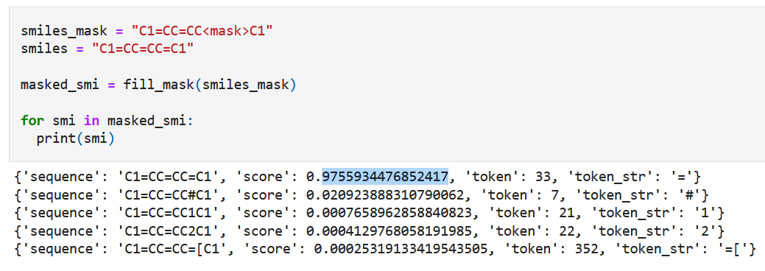
ChemBERTa: prediction
Example showing a masked section of a molecule (benzene) and what the model predicts
Taken from: https://github.com/deepchem/deepchem/blob/master/examples/tutorials/Transfer_Learning_With_ChemBERTa_Transformers.ipynb

Slide 57
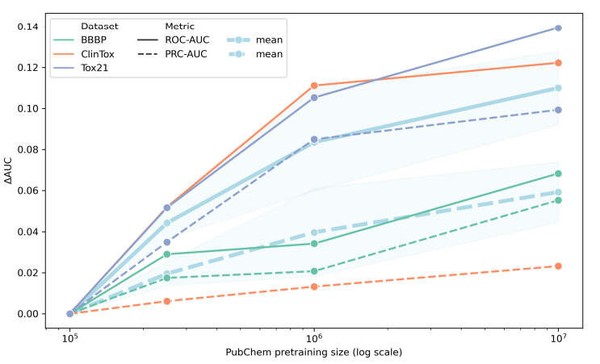
ChemBERTa: results
By pre-training on SMILES the model learns a strong molecular representation.
Then the model is finetuned for a specification task (e.g., toxicity, BBBP, etc)
While the performance is quite poor, it continues to increase with increasing amount of data
Interesting ethically concerning side effect – models that can recognize toxic molecules, models can also generate toxic molecules
Link to paper
Article about paper: https://www.theverge.com/2022/3/17/22983197/ai-new-possible-chemical-weapons-generative-models-vx
Notes:
Fine-tuning == Transfer learning: using knowledge gained while solving one problem and applying it to a different but related problem.
model normally penalizes predicted toxicity and rewards predicted target activity. This logic was inverted by using the same approach to design molecules de novo, but now guiding the model to reward both toxicity and bioactivity instead.

Slide 58
Fourth notebook: 04_asignment_BBB_ChemBERTa.ipynb

Slide 59
If we have time....
Notes:
Make as group

Slide 60
Multilingual molecular representations
SMILES is one possible way to represent a molecule
As we saw earlier, IUPAC name is another way to represent molecules
2022 paper from Microsoft research used both SMILES and IUPAC representations of molecules to generate molecular embeddings
Link to paper: Multilingual Molecular Representation Learning via Contrastive Pre-training 2022

Slide 61
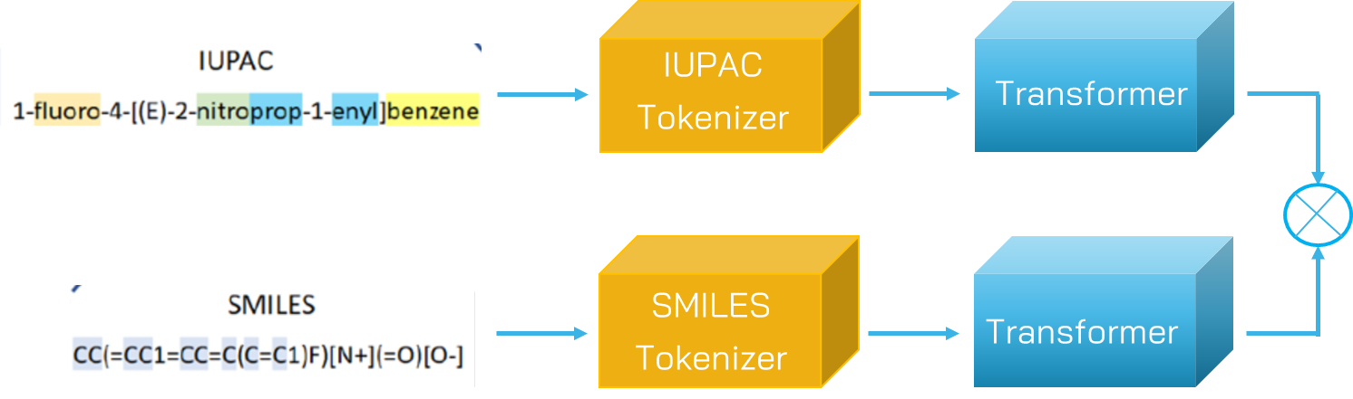
Multilingual molecular representations
Contrastive
objective
Uses contrastive learning to train the transformer
This has the effect of pushing embeddings of positive cross-lingual pairs (SMILES and IUPAC for the same molecule) closer together, and negative pairs embeddings further apart
This could be a better approach for creating more generalized embeddings than masked training
Both molecule descriptors (IUPAC and SMILES) are integrated into the 1 embedding

Slide 62
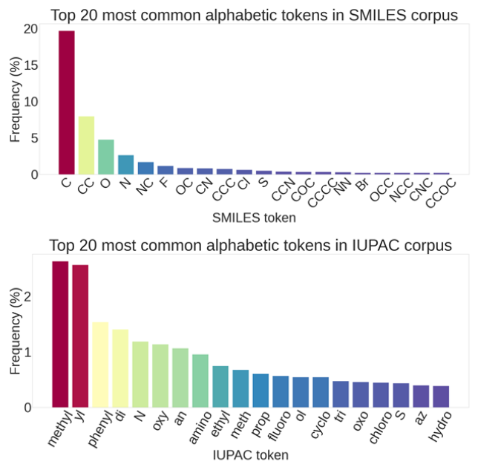
Multilingual molecular representations
Most common terms in the SMILES and IUPAC alphabets
IUPAC names brings prior knowledge in the form of words representing functional groups

Slide 63
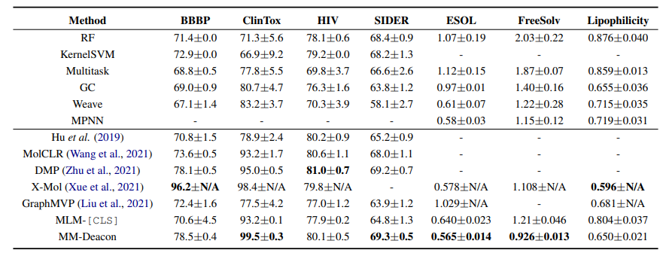
Multilingual molecular representations
Model performs quite well on a range of tasks for predicting molecule properties

Slide 64
Fifth notebook: 05_BBB_combined_txtSMILE.ipynb

Slide 65
Workshop structure
Introduction to drug discovery and diseases
What are proteins and small molecules?
How to use machine learning for drug discovery?
Data sources and feature representations
Introduction to NLP on language as we know it
NLP for drug discovery
NLP for small molecules
The future of AI in drug discovery

Slide 66
The future of AI in drug discovery

Slide 67
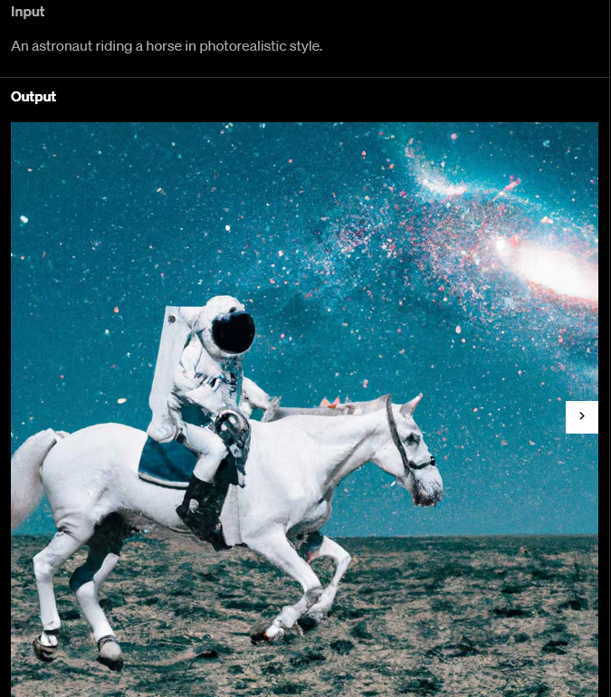
AI model for drug generation
DALL-E 2 can create original, realistic images and art from a text description
Combining concepts, attributes, and styles.
Provides semantic level control of images
This is possible by learning a joint representation of image and text
How about describing the molecule you require for curing a disease and the AI system would design that molecule for you?

Slide 68
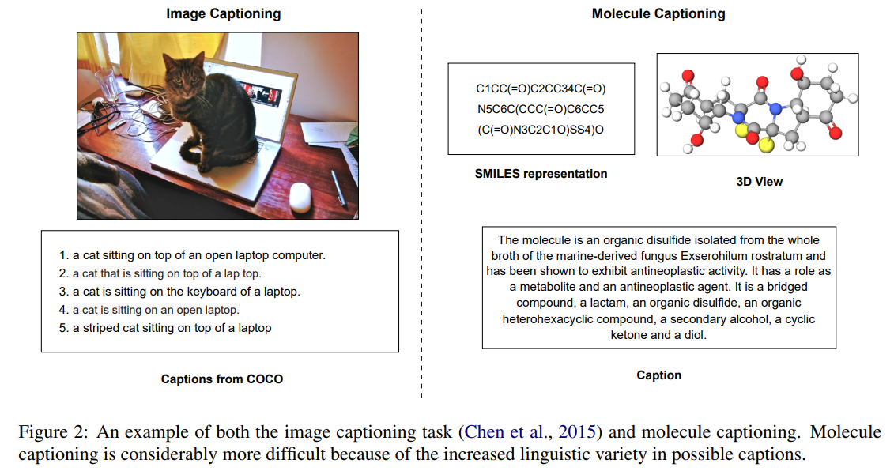
AI model for drug generation: Moonshot
From collab between the University of Illinois and X the moonshot factory
Big picture: to be able to describe a molecule in text and receive the structure of such a molecule fitting that description

Slide 69
AI model for drug generation: Moonshot
From collab between the University of Illinois and X the moonshot factory
Big picture: to be able to describe a molecule in text and receive the structure of such a molecule fitting that description
Notes:
How to define the caption and what information it should contain is a challenge – but can imagine it being a help in finding a possible suitable molecule

Slide 70
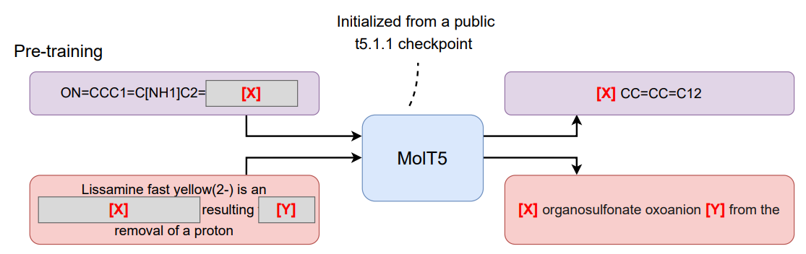
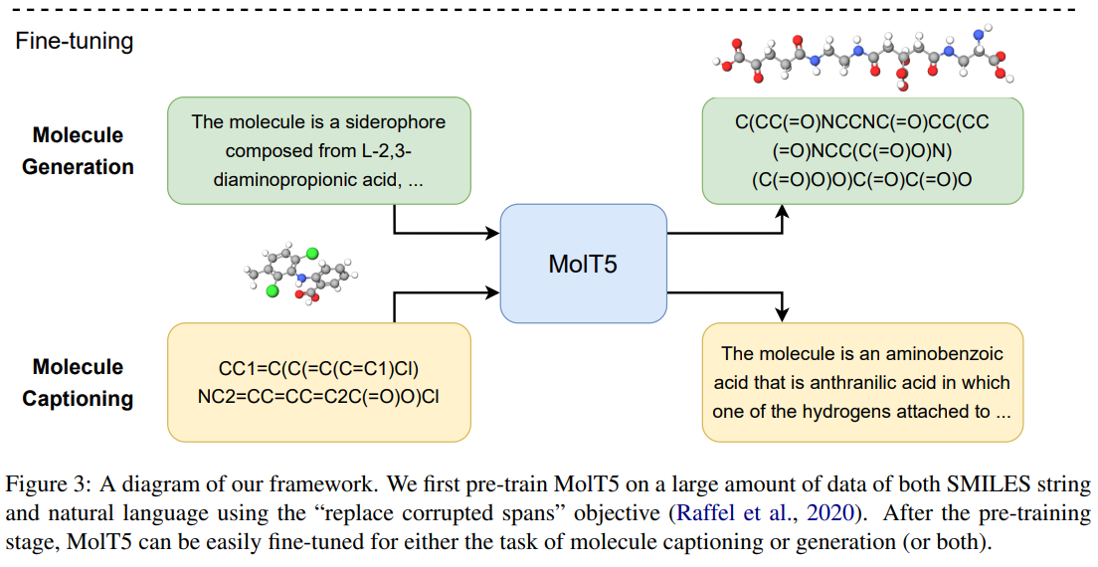
AI model for drug generation: Approach
Transformer model trained (self-supervised) on masked SMILES and masked text descriptions
2-way ability:
Given molecule can generate a caption for it – this can help scientists understand a new molecule
Given a text description it can generate a molecule matching that description
Fine tuned on small labelled dataset

Slide 71
AI model for drug generation: Results and challenges
Achieves 30% exact matching test accuracy - performance is not great but potential is huge
Creating annotations for molecules requires significant domain expertise – much less training data available than for images
The same molecule can have many functions and thus be described in very different ways (properties, functions, pre-cursers, functional groups, etc.)
Notes:
i.e., it generates the correct structure for about one-third of the captions in the held-out test set

Slide 72
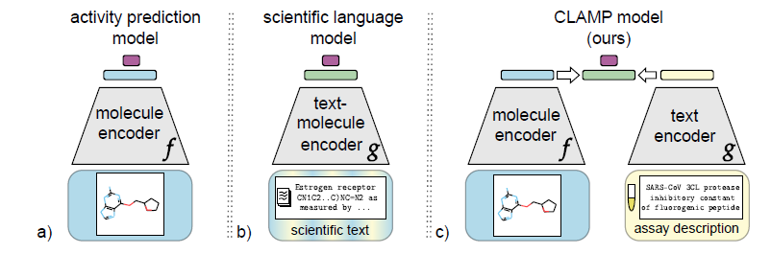
Gaining traction: Enhancing Models in Drug Discovery with the Ability to Understand Human Language
Models typically trained to predict some property/activity of molecules
NLP models can understand text quite well
Join these together – associate the text information about the molecule with the structural information of the molecule
Code available here: ml-jku/clamp (github.com)

Slide 73

The parting glass
82-year-old patient, blood cancer, no cancer drugs were working
Doctors took samples of healthy tissue and cancerous cells
Sent them to Exscientia where they were testing a new technology
The samples were divided into more than a hundred pieces and exposed to various drugs
Used CV ML models to detect changes in cells (death/proliferation)
The model found a cancer drug that killed the cancerous cells – this drug was from Johnson & Johnson
Doctors had not tried it because previous trials had suggested it was not effective at treating blood cancer
It worked. Two years on, the patient was in complete remission
Later, tested 139 drugs on 12 patients, found drugs for more than half
https://www.technologyreview.com/2023/02/15/1067904/ai-automation-drug-development
Notes:
Scottish song but sang a lot in Ireland, Final drink for departing guest once they had mounted their horse

Slide 74
Back-up

Slide 75
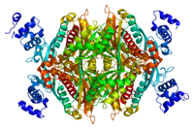
NLP for proteins
Protein sequences are a rich source of information about proteins
The protein sequences can also be used to train a language model – even though they are not a language in the way we know
They have language-like properties: structure, repeating parts etc.
Notes:
proteins in the same family have similar sequences,
constraints in which amino acids can go after each other

Slide 76
NLP for proteins
Protein sequences (see across) are broken up into 3 letter "biological words" (3 amino acids)​
MAF, AFS, FSA, SAE, AED, EDV, …​
AFS, FSA, SAE, AED, EDV, DVL, …​
FSA, SAE, AED, EDV, DVL, VLK, ...​
We can generate word embeddings (numerical representations) for these proteins just as we did for words in PubMed text​
Protein sequence embeddings
NLP
Protein sequences
(0.5 million)
PD-L1
FOX-P3
Notes:
Reviewed and annotated sequences from UniProt

Slide 77
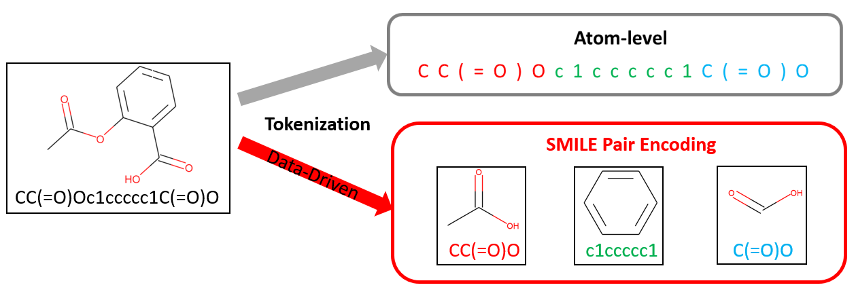
Molecular BERT: how it works
Byte-wise encoding for SMILES shown below in comparison with atom-level encoding
Idea: subgroups of molecules have common meaning, e.g., toxicity, solubility
Notes:
Why is this useful? It could lead to predictions of novel molecules outside our training dataset – often it is desirable to find a new molecule
Caveat with this: it may predict physically implausible molecules
variants of a molecule to be predicted, e.g., one section is masked and this could lead to a different variant of the input molecule being predicted

Slide 78
Data sources for drug discovery
NLP model
Text embeddings
NLP model
SMILES embeddings
SMILES
CC(C)C1=C(C(=C(N1CCC(CC(CC(=O)O)O)O)...
calcium;(3R,5R)-7-[2-(4-fluorophenyl)-3-phenyl-4-(phenylcarbamoyl)-5-propan…
NLP model
IUPAC embeddings
IUPAC
Amino acid sequence
AFS, AED, VLK, EYD, RRR, RME, …​
NLP model
Protein sequence
embeddings

Slide 79
Case study: Classify molecules based on their ability to cross the blood-brain barrier

Slide 80
Reuse
NLP models are expensive to train
Many pre-trained models exist that are publicly available
contains ~200k models!
We will use pre-trained models from in this workshop

Slide 81
How to prepare a labeled dataset?
Need domain experts for labelling unlabeled datasets
Or find pre-made dataset from a publication
Caution required when making claims about what your model can do....
e.g., classifying dogs vs sheep or classifying white vs non-white

Slide 82
IUPAC
Tokenizer
Transformer
SMILES
Tokenizer
Transformer

Slide 83
Graph representations of molecules
Message passing neural networks, graph neural networks
Antibiotics paper…
Advantage over text embeddings in that completely new molecules can be predicted (but with byte-wise encoding a new molecule could also be created?)

Slide 84

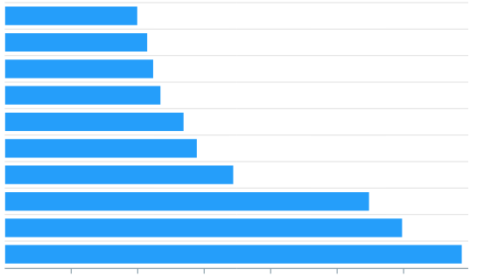
Stage 2
Text embeddings
Dataset for finetuning
Large database of molecules for testing
Trained ML model
Dataset joined to embeddings
Trained ML model
Scored molecules

Slide 85
Our problem – cancer drug
Normally, our immune system detects and destroys abnormal cells preventing them from growing into cancerous tumors
Drug is used to stimulate the immune system to fight the cancer
One dose costs $20,958 !
Large potential to discover more molecules that regulate the immune system
Our goal is to build a model that identifies these regulators of the immune system

Slide 86
Classification problem
Is the molecule an immune regulator or not?
Molecule dataset
(120 molecules)
PubMed
NLP model
Classifier
Model performance
Trained on published scientific articles
Immune regulator classifier
Classifies molecules as immune regulators or not (binary)

Slide 87
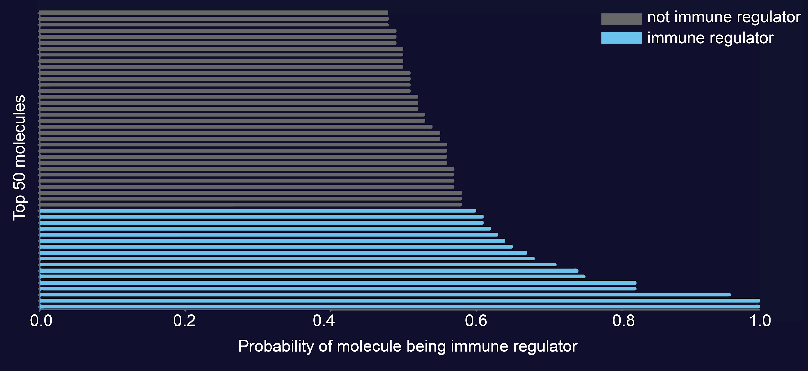
How to find immune regulators that are not yet known?
How many immune regulators could be developed in the future or should be investigated further
We scored database of 22k molecules, top 50 shown
Quick and easy to create molecule shortlist

Slide 88
Summary
Challenges
Datasets with small sample sizes – need to deal with overfitting
Very imbalanced datasets
Data is not open-sourced besides PubMed – majority of scientific articles are behind paywall
Interpretability of embeddings is lacking
Many start-ups in this area but many are failing due to massive costs in bringing a drug to approval – requires large investment support
AI developed drugs in clinical trials – none yet approved

Slide 89
Summary
Benefits
ML has shown huge potential in helping with drug discovery
Rewarding to use ML in this way
Language model works well even on non-linguistic data (protein sequences)
Language model captures complex medical concepts
Latent knowledge regarding future molecule discoveries can be extracted from past publications
High return in case of success

